Slide 1

GPU ACCELERATION IN MACHINE LEARNING From a graphics processing unit to a unparallel fast machine learning processor
Σπυριδωνίδης Δημήτρης

Slide 2
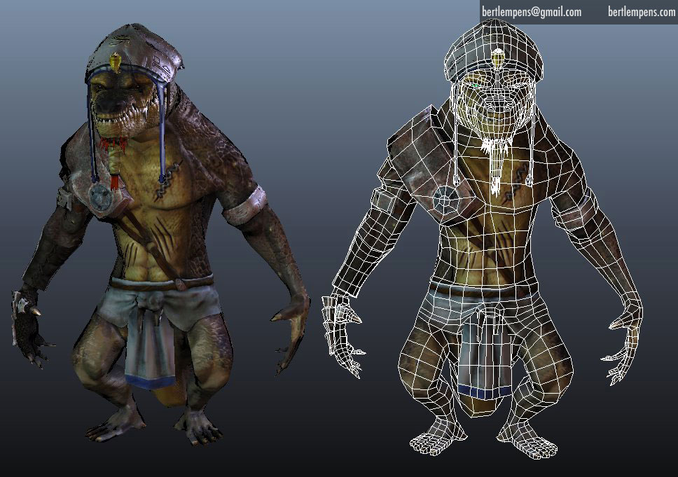
Computer Graphics
In this section we will discuss the math behind computer graphics and what it takes to have a 3D model projected in a 2d screen
How such computations can be accelerated on specialized hardware such as a GPU and the architecture difference between the GPU and the CPU

Slide 3
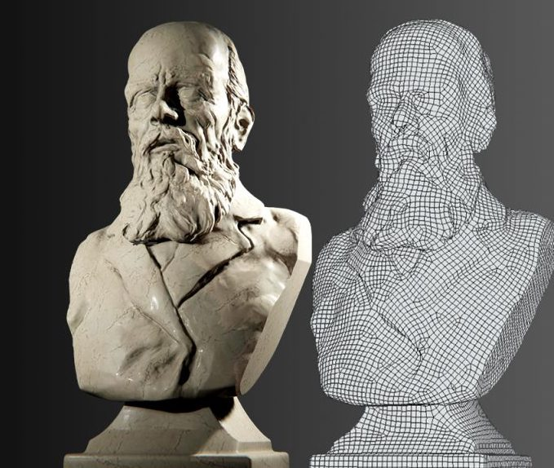
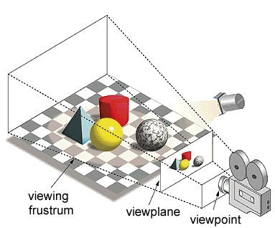
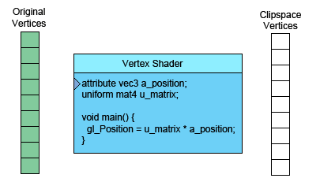
Each model in a scene is made from 3D point “vertices” , those vertices make triangles than make the surface of the object. To be able to see the 3D model on our 2D screen each vertex of the object has to go under a transformation. First the it has to be moved from it’s local space to the world space, then from the world space to the view space and finally to be projected on a 2d plane This process has to be done for every vertex of our model and for every model in the scene.

Slide 4
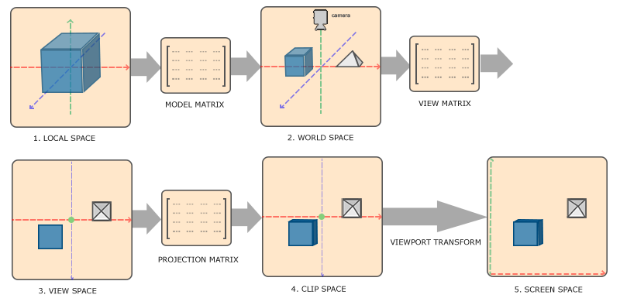
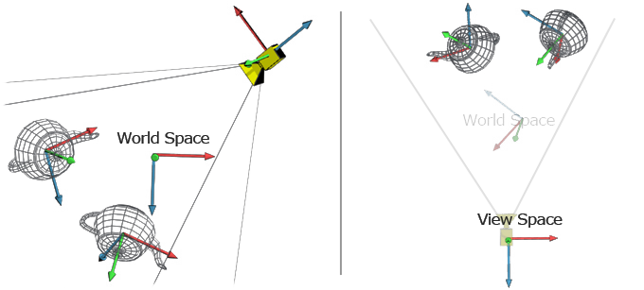
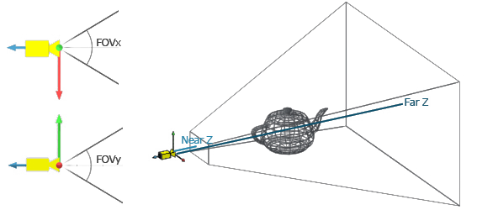

Slide 5
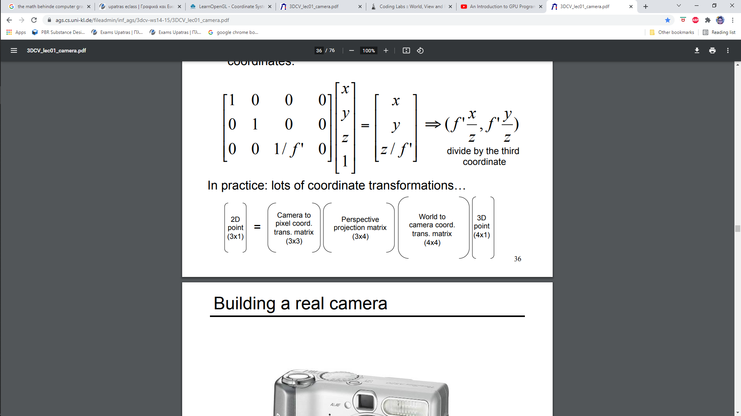


Each transformation is done by multiplying our 3D cord(vertex) by a matrix. The get the final screen coordinates we have to multiplying our original 3D cord by 3 matrices one for each transformation.
Local to world cord.
trans. matrix

Slide 6
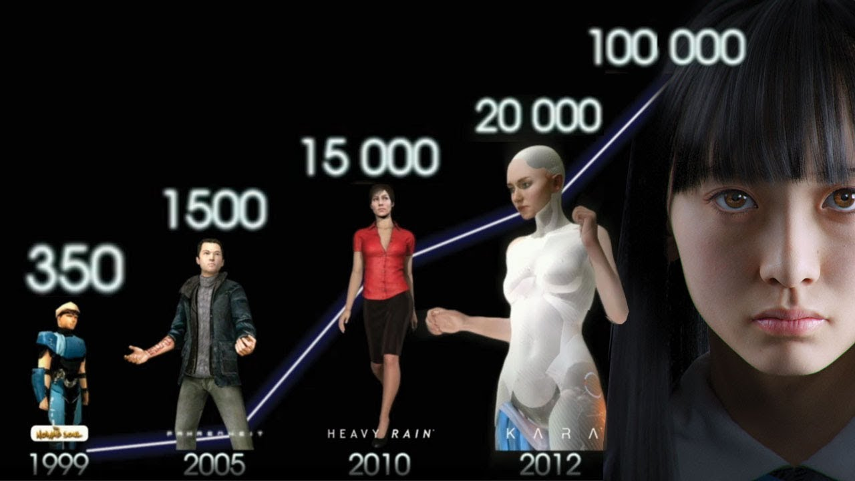
As video games evolved over the year the number of polygons increased so we can have a more detailed world. Modern video game characters have over 100 of thousands of polygons so to render a hole scene our processor has to render millions of triangles every frame

Slide 7
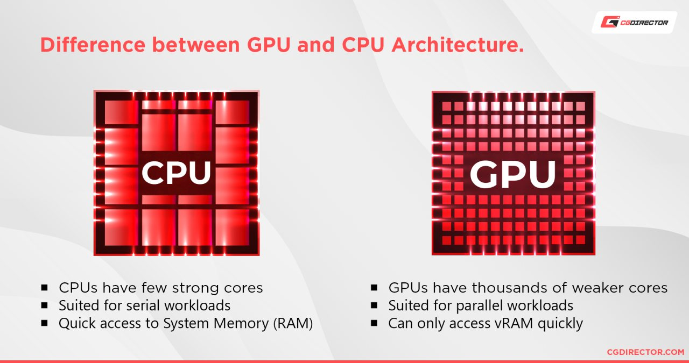
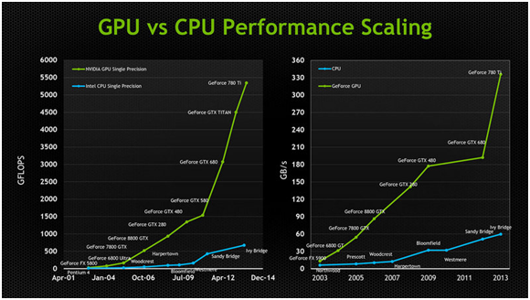
As the popularity of video games rose so did the demand for more detailed and more beautiful scenes. Because every triangle can be rendered independently from the others and a CPU as a serial based processor could not keep up with the rising computational demand of video games , new processor architecture was developed that was specialized in doing a lot simple linear algebra computations in parallel named GPU.

Slide 8
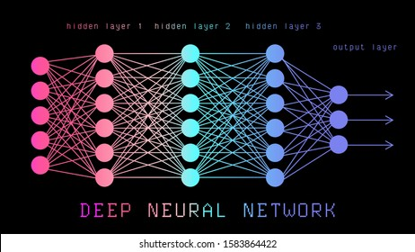
Neural Networks and the GPU

Slide 9



As advancement's in machine learning were made and neural networks became more and more popular it was obvious that the GPU is the perfect processor to run the computations that are needed to train a neural network that are highly parallelizable liner algebra operations as did the video games for witch it was originally developed. There are several tools to write code in the GPU as openACC, openCL and CUDA. Today we are going to focus on how accelerate a neural network training using CUDA. But first we are going to see the math behind neural networks and how to run one on the cpu.

Slide 10
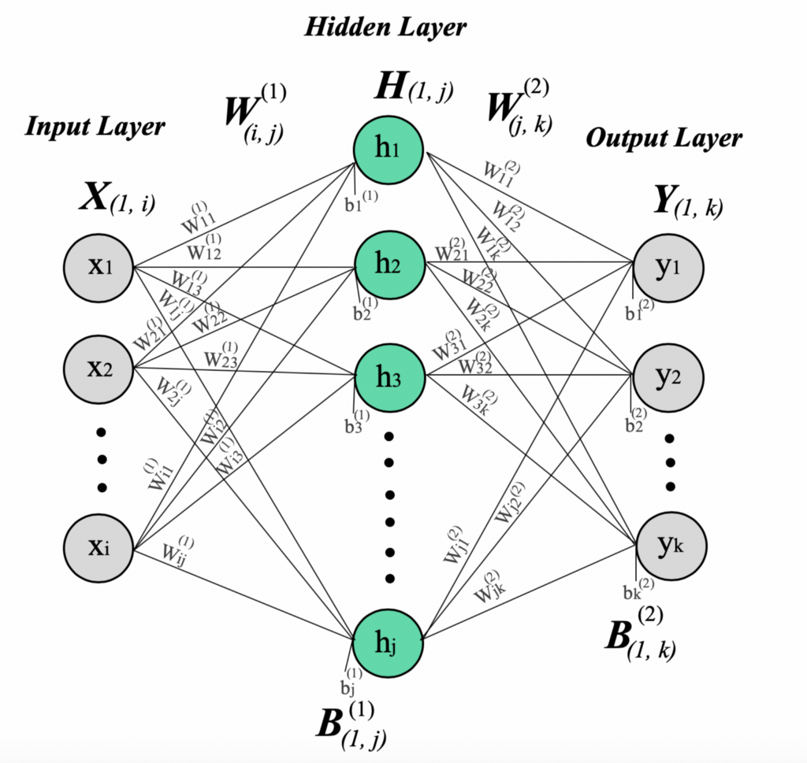
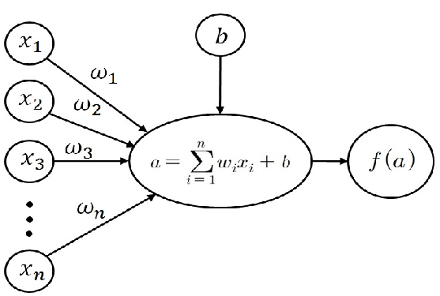
The math behind neural networks
All the operations behind training a neural networks are matrix multiplications for this example we are going to use a neural network that has 784 neurons as input, 1000 neurons as a hidden layer an 10 output neurons. First we are going to analyse and demonstrate the math behind our neural network

Slide 11
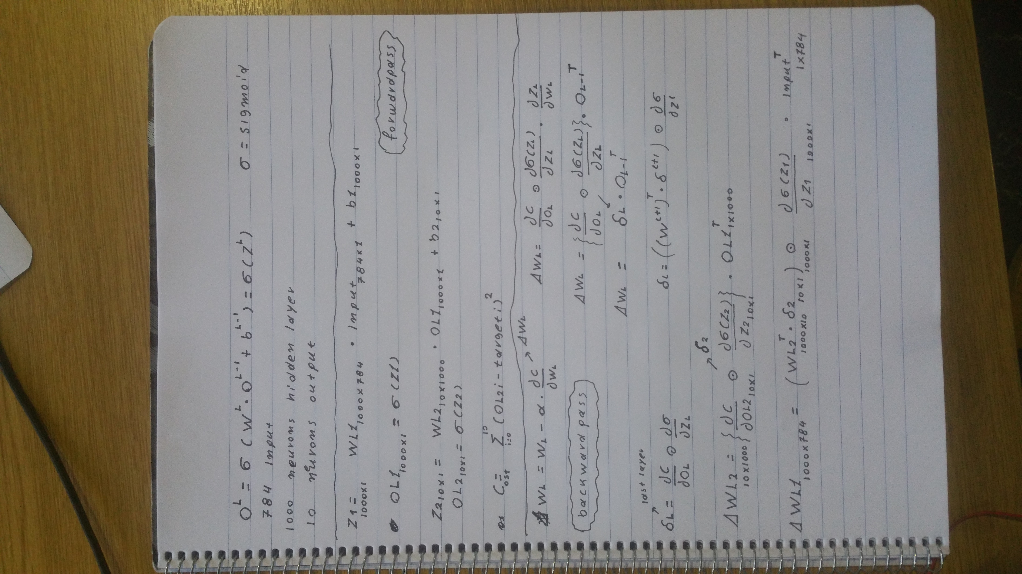

Slide 12
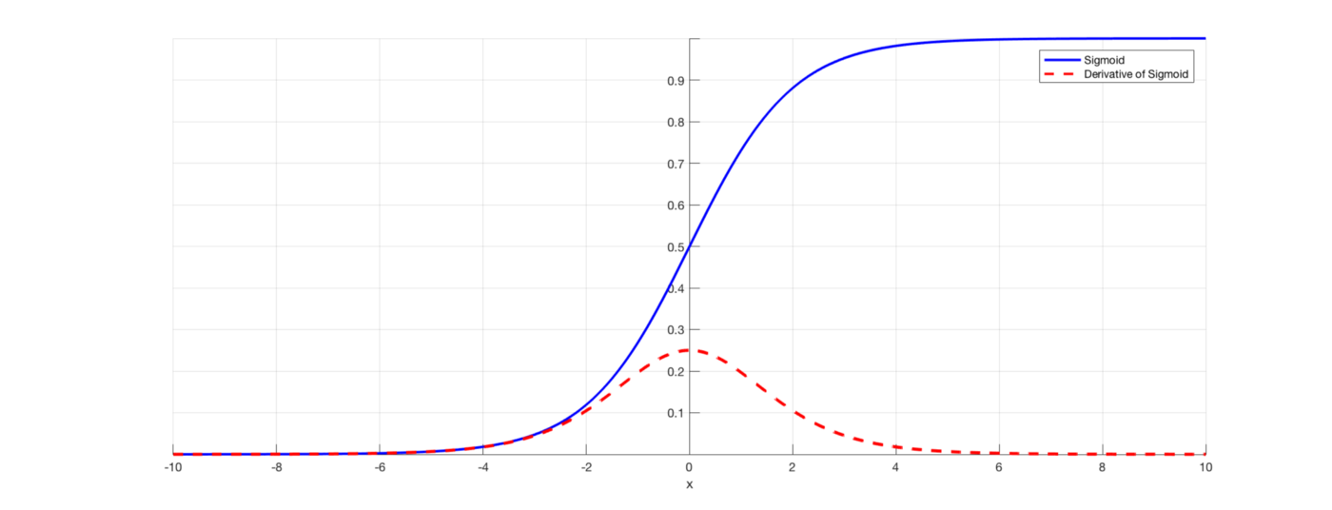
For this example we are going to use the mnist dataset and train the network for 60000 epochs and see how much time it takes, one important note is because the changes that we do in weights depend on the derivative of the sigmoid which is 0 when the sigmoid is close to 0 or 1 so the weights don’t change. To overcome this problem we add a small value to the derivative of the sigmoid.

Slide 13
The calculation for our network are done by this 3 functions
void activateNN(float* Vector){
#pragma omp parallel for
for (int i = 0; i < L1; i++) {
OL1[i] = 0;
for (int y = 0; y < N; y++)
OL1[i] += WL1[i][y] * Vector[y];
OL1[i] += WL1[i][N];
OL1[i] = activation_Sigmoid(OL1[i]);
}
#pragma omp parallel for
for (int i = 0; i < L2; i++) {
OL2[i] = 0;
for (int y = 0; y < L1; y++)
OL2[i] += WL2[i][y] * OL1[y];
OL2[i] += WL2[i][L1];
OL2[i] = activation_Sigmoid(OL2[i]);
}
}
void trainNN(float* input, float* target)
{
#pragma omp parallel for
for (int i = 0; i <L2 ; i++) {
for (int j = 0; j < L1; j++) {
WL2[i][j] -= a * EL2[i] * OL1[j];
}
WL2[i][L1] -= a * EL2[i];
}
#pragma omp parallel for
for (int i = 0; i < L1; i++) {
for (int j = 0; j < N; j++) {
WL1[i][j] -= a * EL1[i] * input[j];
}
WL1[i][N] -= a * EL1[i];
}
}
void calc_Error(float *target) {
#no reason for parallelization we lose time
for (int i = 0; i < L2; i++) {
EL2[i] = (OL2[i] - target[i]) * (derivative_Sigmoid(OL2[i])+a);
}
#pragma omp parallel for
for (int i = 0; i < L1; i++) {
EL1[i] = 0;
for (int i2 = 0; i2 < L2; i2++) {
EL1[i] += EL2[i2] * WL2[i2][i] * (derivative_Sigmoid(OL1[i])+a);
}
}
}

Slide 14
We run our code on google colab. Time for 60000 epochs no optimization 6 min 22 sec. We run the code a second time now taking advantage of vectorization and using both threads of the CPU. Time for 60000 epochs -O3 optimization plus using 2 threads 53sec 7.2x faster. Now that we have made our neural network as fast as possible on the CPU it’s time to try to run it on the GPU. First we are going to make a fast intro to CUDA

Slide 15
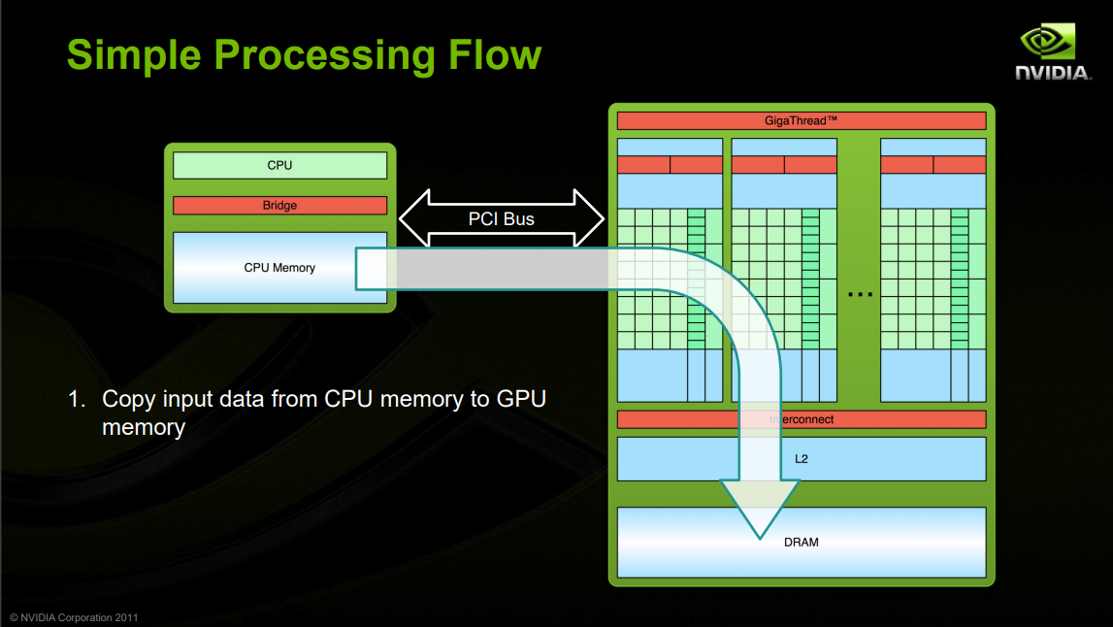

Slide 16
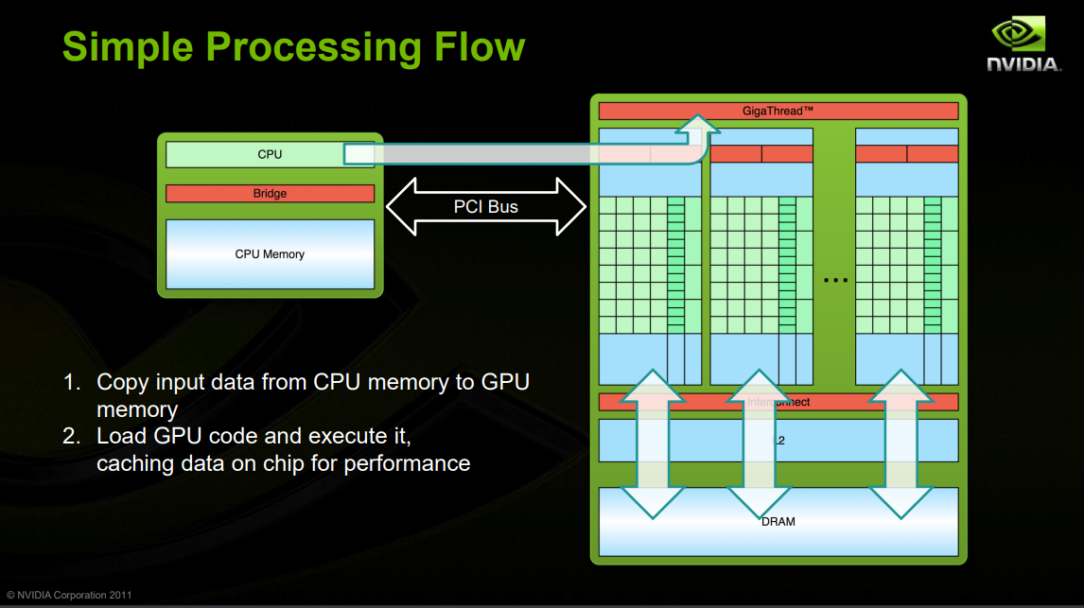

Slide 17
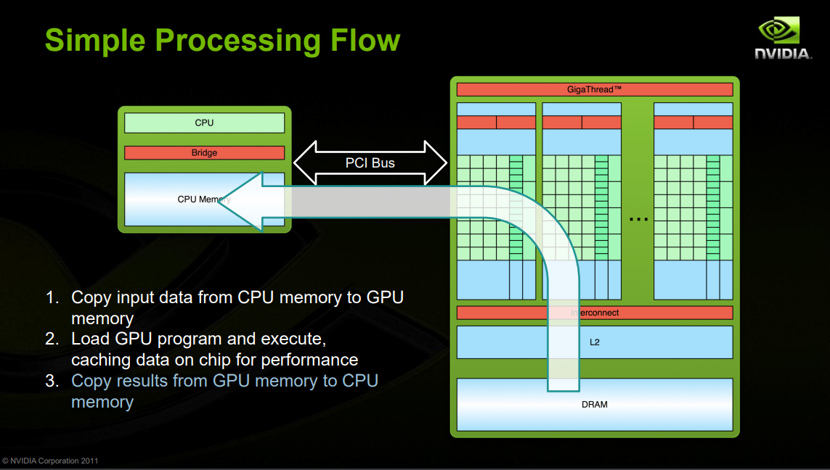

Slide 18
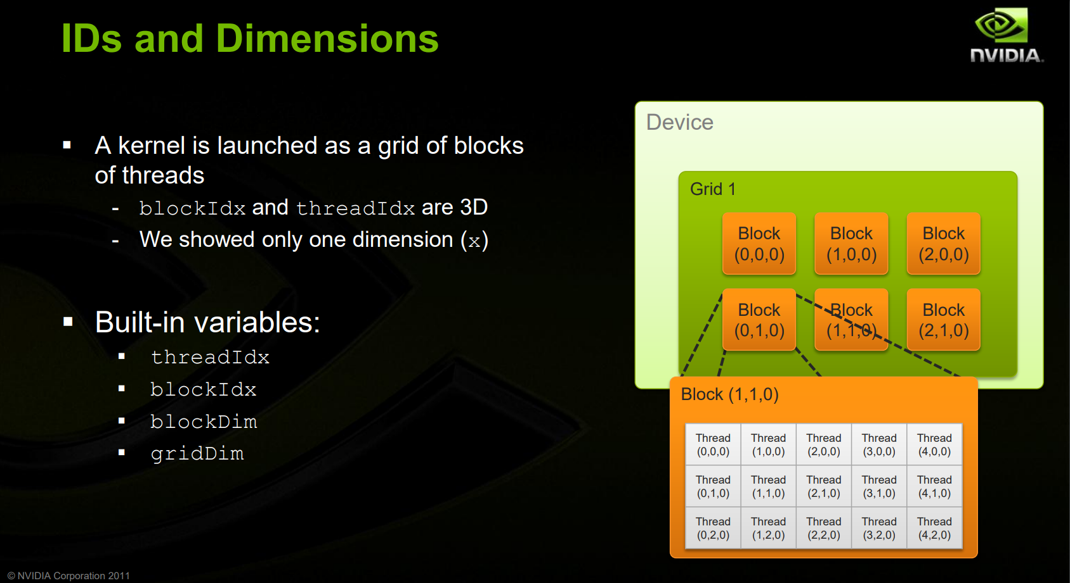

Slide 19


Slide 20
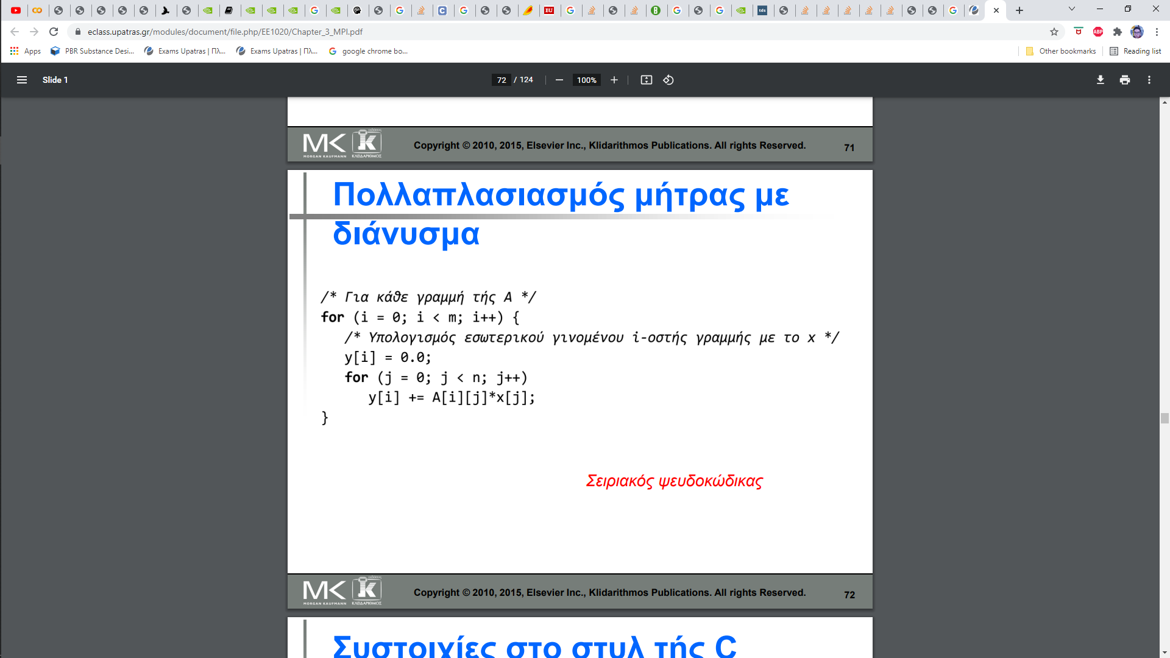
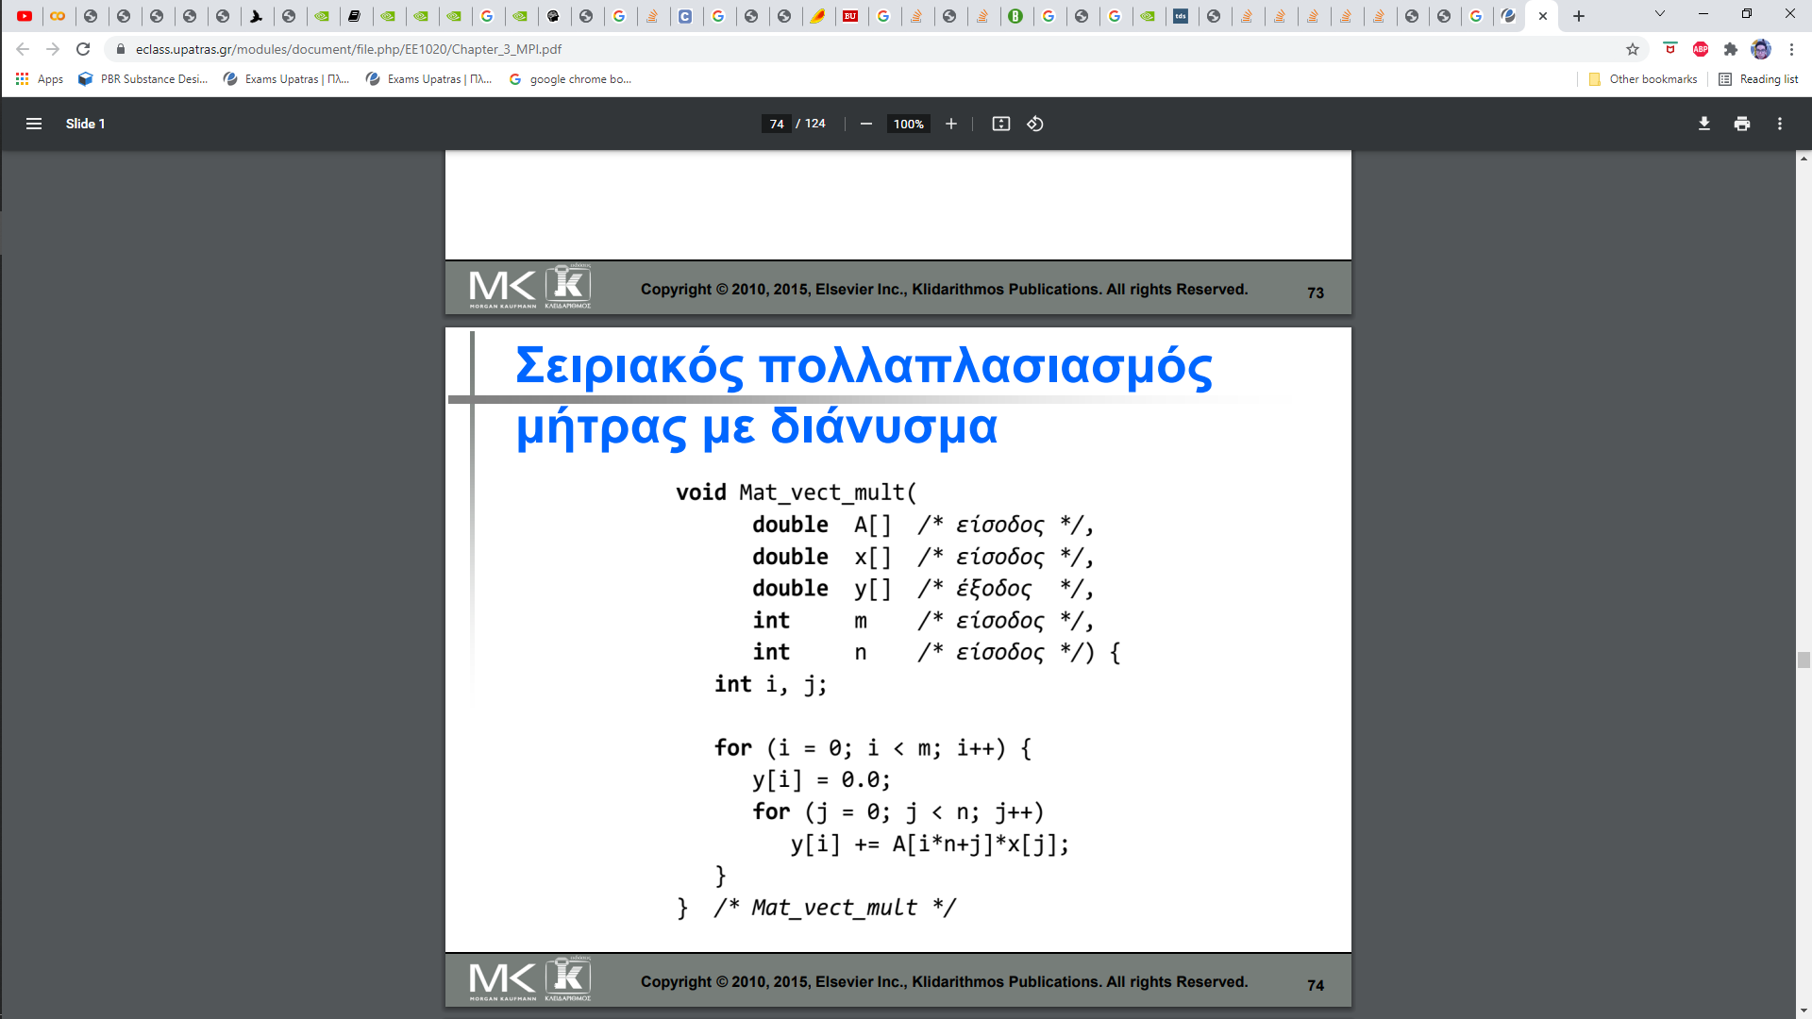
CUDA loads one dimensional array of pointers to the GPU so we have to change our 2D matrices to 1D arrays

Slide 21
Now we are going to spread each loop of our functions between threads of the GPU.
Below the main 3 functions in CUDA.
__global__ void activateNN(float* Input, int index, float* WL1, float* WL2,
float* OL1, float* OL2){
int thr_index = blockDim.x * blockIdx.x +threadIdx.x;
int stride = blockDim.x * gridDim.x;
for (int i = thr_index; i < d_L1; i+=stride) {
OL1[i] = 0;
for (int y = 0; y < d_N; y++)
OL1[i] += WL1[i*d_N+y] * Input[index*d_N+y];
OL1[i] += WL1[i*d_N+d_N];
OL1[i] = activation_Sigmoid(OL1[i]);
} __syncthreads();
for (int i = thr_index; i < d_L2; i+= stride) {
OL2[i] = 0;
for (int y = 0; y < d_L1; y++)
OL2[i] += WL2[i*d_L1+y] * OL1[y];
OL2[i] += WL2[i*d_L1+d_L1];
OL2[i] = activation_Sigmoid(OL2[i]);
} }
__global__ void trainNN(float* input, float* target, int index, float* WL1, float* WL2, float* OL1, float* OL2, float* EL1, float* EL2)
{
int thr_index = blockDim.x * blockIdx.x +threadIdx.x;
int stride = blockDim.x * gridDim.x;
for (int i = thr_index; i <d_L2 ; i+=stride) {
for (int j = 0; j < d_L1; j++) {
WL2[i*d_L1+j] -= a * EL2[i] * OL1[j];
}
WL2[i*d_L1+d_L1] -= a * EL2[i];
}
__syncthreads();
for (int i = thr_index; i < d_L1; i+=stride) {
for (int j = 0; j < d_N; j++) {
WL1[i*d_N+j] -= a * EL1[i] * input[index*d_N+j];
}
WL1[i*d_N+d_N] -= a * EL1[i];
}
}
__global__ void calc_Error(float *target, int index, float* WL2, float* OL1,
float* OL2, float* EL1, float* EL2) {
int thr_index = blockDim.x * blockIdx.x +threadIdx.x;
int stride = blockDim.x * gridDim.x;
for (int i = thr_index; i < d_L2; i+=stride) {
EL2[i] = (OL2[i] - target[index*d_L2+i]) * (derivative_Sigmoid(OL2[i])+a);
}
__syncthreads();
for (int i = thr_index; i < d_L1; i+=stride) {
EL1[i] = 0;
for (int i2 = 0; i2 < d_L2; i2++) {
EL1[i] += EL2[i2] * WL2[i2*d_L2+i] * (derivative_Sigmoid(OL1[i])+a);
}
} }

Slide 22
We run the algorithm again using the GPU of google Collab, the GPU that was used is tesla K80. Training took 11 min, slower than the CPU ? . The truth is that we are not utilizing fully the power of GPU with this simple algorithm because we have a lot of threads that go unused. In forward pass we have each thread calculate the output of one neuron which is a sum. The first optimization that we can do is to use even more threads to do reduction on the sum. The second is when we update the weights we use use one thread to update the weights of each neuron , so we simply going to assign one thread per weight.

Slide 23
__device__ void warpReduce(volatile float* sdata, int tid) {
sdata[tid] += sdata[tid + 32];
sdata[tid] += sdata[tid + 16];
sdata[tid] += sdata[tid + 8];
sdata[tid] += sdata[tid + 4];
sdata[tid] += sdata[tid + 2];
sdata[tid] += sdata[tid + 1];
}
__global__ void activateNN_L1(float* Input, int index, float* WL1, float* WL2, float* OL1, float* OL2){
__shared__ float sInput[d_N+240];
unsigned int block_index = blockIdx.x;
unsigned int thr_index = threadIdx.x;
if(block_index<d_L1 && thr_index<d_N)
sInput[thr_index] = WL1[block_index*d_N+thr_index] * Input[index*d_N+thr_index];
else if (block_index<d_L1 && thr_index>=d_N && thr_index<d_N+240)
sInput[thr_index] = 0;
__syncthreads();
if(block_index<d_L1) {
if (thr_index < 512) sInput[thr_index]+= sInput[thr_index+512];
__syncthreads();
if (thr_index < 256) sInput[thr_index]+= sInput[thr_index+256];
__syncthreads();
if (thr_index < 128) sInput[thr_index]+= sInput[thr_index+128];
__syncthreads();
if (thr_index < 64) sInput[thr_index]+= sInput[thr_index+64];
__syncthreads();
if (thr_index < 32) warpReduce(sInput, thr_index);
if(thr_index == 0){
OL1[block_index] = sInput[0] + WL1[block_index*d_N+d_N];
OL1[block_index] = activation_Sigmoid(OL1[block_index]);
}
}
}

Slide 24
__global__ void activateNN_L2(float* Input, int index, float* WL1, float* WL2, float* OL1, float* OL2){
__shared__ float sInput[d_L1+24];
unsigned int block_index = blockIdx.x;
unsigned int thr_index = threadIdx.x;
if(block_index<d_L2 && thr_index<d_L1)
sInput[thr_index] = WL2[block_index * d_L1 + thr_index] * OL1[thr_index];
else if (block_index<d_L2 && thr_index>=d_L1 && thr_index < d_L1+24)
sInput[thr_index] = 0;
__syncthreads();
if(block_index<d_L2) {
if (thr_index < 512) sInput[thr_index]+= sInput[thr_index+512];
__syncthreads();
if (thr_index < 256) sInput[thr_index]+= sInput[thr_index+256];
__syncthreads();
if (thr_index < 128) sInput[thr_index]+= sInput[thr_index+128];
__syncthreads();
if (thr_index < 64) sInput[thr_index]+= sInput[thr_index+64];
__syncthreads();
if(thr_index<32) warpReduce(sInput, thr_index);
if(thr_index == 0){
OL2[block_index] = sInput[0] + WL2[block_index*d_L1+d_L1];
OL2[block_index] = activation_Sigmoid(OL2[block_index]);
}
}
}

Slide 25
__global__ void calc_Error(float *target, int index, float* WL2, float* OL1, float* OL2, float* EL1, float* EL2) {
int thr_index = blockDim.x * blockIdx.x +threadIdx.x;
int stride = blockDim.x * gridDim.x;
for (int i = thr_index; i < d_L2; i+=stride) {
EL2[i] = (OL2[i] - target[index*d_L2+i]) * (derivative_Sigmoid(OL2[i])+a);
}
__syncthreads();
for (int i = thr_index; i < d_L1; i+=stride) {
EL1[i] = 0;
for (int i2 = 0; i2 < d_L2; i2++) {
EL1[i] += EL2[i2] * WL2[i2*d_L2+i] * (derivative_Sigmoid(OL1[i])+a);
}
}
}
__global__ void trainNN(float* input, float* target, int index, float* WL1, float* WL2, float* OL1, float* OL2, float* EL1, float* EL2)
{
int i = blockIdx.x;
int j = threadIdx.x;
if(i<d_L2 && j<d_L1+1){
if(j < d_L1)
WL2[i*d_L1+j] -= a * EL2[i] * OL1[j];
else
WL2[i*d_L1+d_L1] -= a * EL2[i];
}
if(i<d_L1 && j<d_N+1){
if(j < d_N)
WL1[i*d_N+j] -= a * EL1[i] * input[index*d_N+j];
else
WL1[i*d_N+d_N] -= a * EL1[i];
}
}

Slide 26
Total execution time 15.8 sec 4x times speed up from CPU. There further optimization that can be done but we will stop here. The complete code can be found in this link. https://colab.research.google.com/drive/19WIwktQKzfbo19yShuJAJVjrNHY6xGO5?usp=sharing

Slide 27

What Became Possible With GPU Acceleration
As training neural networks on GPU is much faster it gave as the ability to train bigger more complex architectures that would not be feasible other wise, and thanks to that very big advancements in machine learning were made. Today machine learning algorithms are used almost every were. Cloud, driving cars, medicine, voice recognition, image-video editing and processing.

